Slide 1
K14
Deep learning aim assist

Slide 2



What?
Video Game
Adjust mouse
Screenshot
Recognizing enemy

Slide 3
Difficulties
Latency: Target is <0.3 s, because human reaction takes that long
Computing power: Should reduce <15 fps in game
Accuracy: No wrong adjustments

Slide 4
Screenshot
Screenshot in Center, 1*512*512*3 array
Takes 0.1 s
Works only with 2560*1440
Pyautogui library is needed

Slide 5
Recognizing enemy
Semantic segmentation
UNET architecture for semantic segmentation
Trained with 1400, 1*512*512*3 images which were cut out of 500, 2560*1440*3 raw images
Training duration ca. 15h on rtx 2080 super.
Output is a grayscale 512*512*1 image, enemy in white (>0)
Prediction takes 0.05-0.1 s

Slide 6
Recognizing enemy
Coordinates
CV2 converts grayscale to a 0(black) or 1(white) image
CV2 searches for 20*20 full 1(white) rectangle as high in the image as possible
Output is the distance from Center to found rectangle
Generating coordinates takes ca. 0.05 s

Slide 7
Adjust mouse
Mouse adjustment with ctypes.windll, some games only accept directX inputs
Adjustment takes ca. 0.05 s

Slide 8
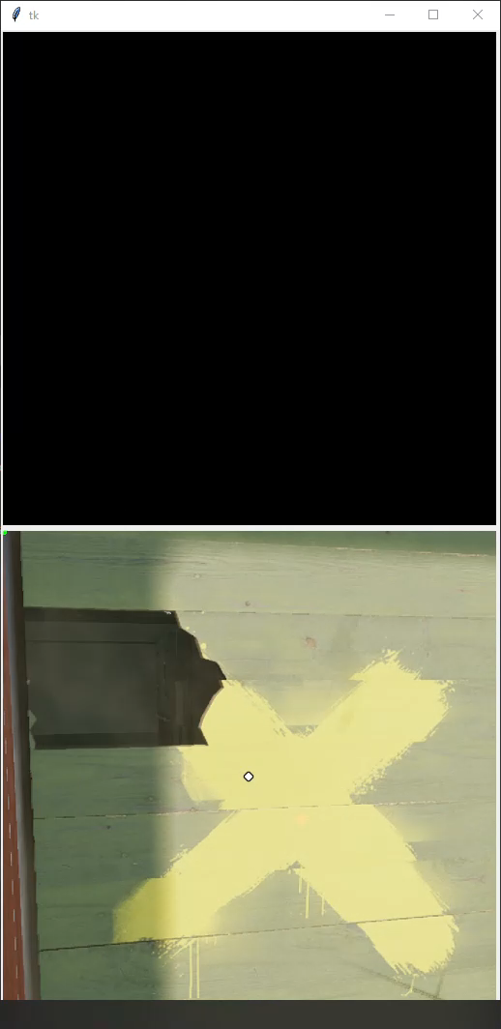
Preview
All processed images are saved.
The above is the semantic prediction mask, the below is the actual screenshot.
Instead of mouse adjustment you see a green dot on the target location

Slide 9
What to improve
limiting factor is the accuracy. To improve quickly:
You could code some sort of filter, so that less but only helpful mouse adjustments happen.
To improve seriously:
Train for longer with same dataset.
Use a pre-trained model on humans(there are some) and on top train with the game specific data.

Slide 10
Data overview
The Model is trained for the game “Rainbow six siege”.
Folder structure is quite self explaining, you can find readme’s.
If you want the Dataset, you can write me an email.

Slide 11
Thank you
I appreciate you came this far.
If you have questions, some thoughts for improvement or anything else feel free to write an email x).

